Slide 1
Online Game Communities
Cecilia ScHraMM +Maxwell Cornwell

Slide 2
gamification
Turn work into something play-like
“Aims at making the labor less alienating – something that will be done willingly, even enthusiastically”
Distinct form playbor, which turns games into labor
Used by companies to increase capital

Slide 3
The history of games
Started out as mostly multiplayer games
Increased graphics gave rise to bigger user worlds/communities
Internet led to open ended worlds + MMORPGs –> bigger communities
Evolved into emergent gameplay + modding
Sandboxed games/user generated content
Minecraft
Super Mario Maker
Social Media games

Slide 4
Online game communities
Similar to physical real-world communities
Form bonds between people
Can overlap
Physical and online meet-ups
Not necessarily gaming, but also modding etc.
“Play communities often have a sense of communal identity based on shared interests, values, aesthetic, and social conventions”
Content created in solitude for community’s use + review
Mods
Levels

Slide 5
Ogc summary
Communities created online are surprisingly strong
Leadership holds groups together
Virtual bonds transcend to the real world
Quality Gameplay
Community
User created content
Refinement + expansion

Slide 6
Gamification + ogc
Play is being commercialized
Gold-farming
Grinding
Account selling
Modding is gamification
Professional gamers in tournament setting
Community members are audience

Slide 7
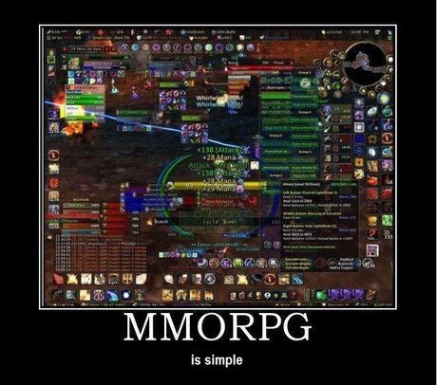
Questions
What other examples of gamificiation do you know?
What are some negative effects of gaming communities?

