Slide 1
Game History
Maxwell Cornwell

Slide 2
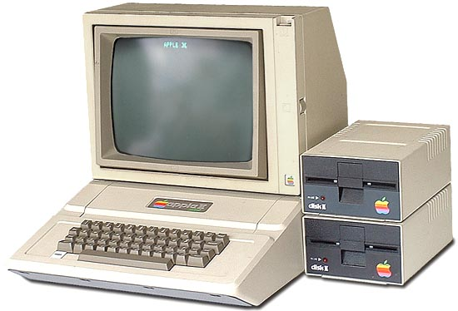
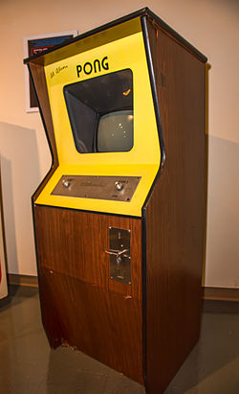
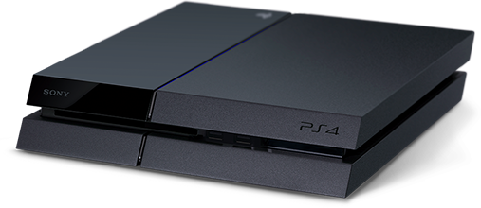
Digital Games
Games have existed on a wide variety of platforms
Not limited to just “computer games” or “videogames”

Slide 3
Earliest Digital Games
Spacewar!(1962)
Tennis For Two (1958)
Games legitimized as way to showcase new computer technology
“University Games”

Slide 4
Commercialization
Collaborative university culture→ business + proprietary games
Coin-operated arcade cabinets (Pong, Computer Space, Pac-Man)
Text based adventure/ dungeons (Oregon Trail, 1971)
Launch of Television based consoles (Magnovox Odyssey)
Grew as technology allowed
“Great Crash” of 1983 (E.T.)
NES (1985) – Quality control and patent protection

Slide 5
Post Crash
Rise of adventure games ( Lucasarts)
Higher production values
Increased abilities with technology
Gaming now mainstream – Emergence of social communities around games
Evolution of games from MUDs( Multi-User Dungeon) to MMORPGS with rise of the internet
Rise of FPS games – Doom(1993), Quake (1996)
Rise of flagship home entertainment consoles

Slide 6
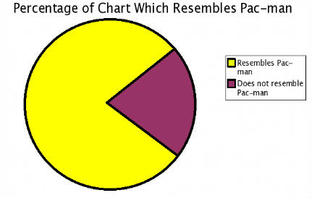
Modern Gaming – Gamification
Rise of greater and greater technology→ showcasing of tech through games (VR worlds, Tennis For Two)
“The basic appeal of gamification is that it has the potential to spur economic activity by influencing the behavior of producers and consumers”(Rey, 278)
Ubiquitous nature of online games → gamification of learning
and educational materials

Slide 7
Questions
Are newer video games inherently better than older ones because of the greater technology used to create them? (Does tech play a role in the ‘goodness’ or playability of a game?)
Has the rise of large production companies through time made gaming too commercialized?

